Slide 1
Team 5 – Rotor Blade Structures
Week No - 3
Date - 14.10.2025
Supervisor - Dr. Laurence Alhrshy
Presented by – Mithun Shetty
Team Members - Bhima B Masare, Anudeep Allanki, Dongsuk Kim, Mithun Shetty

Slide 2
Contents
Rotor Blade Structures Team Time line
Fixing the length of Blade
Fix the nodes along the length of Blade
Blade Root Diameter Details
Data needed to proceed further
Tasks planned for upcoming weeks
Bibliography
Mithun Shetty

Slide 3
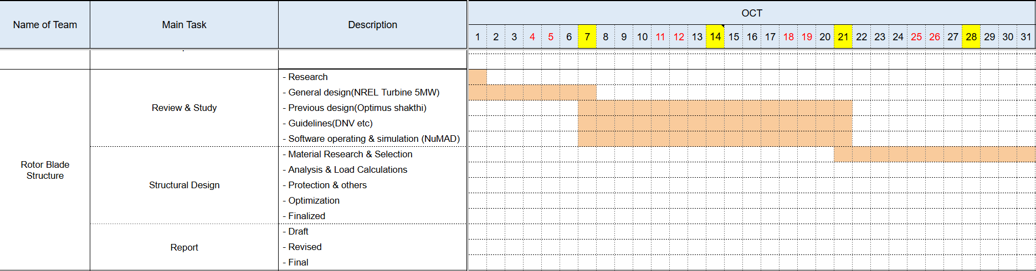
1. Rotor Blade Structures Team Time line -
1.1 Team Time line for Month October -
Mithun Shetty

Slide 4
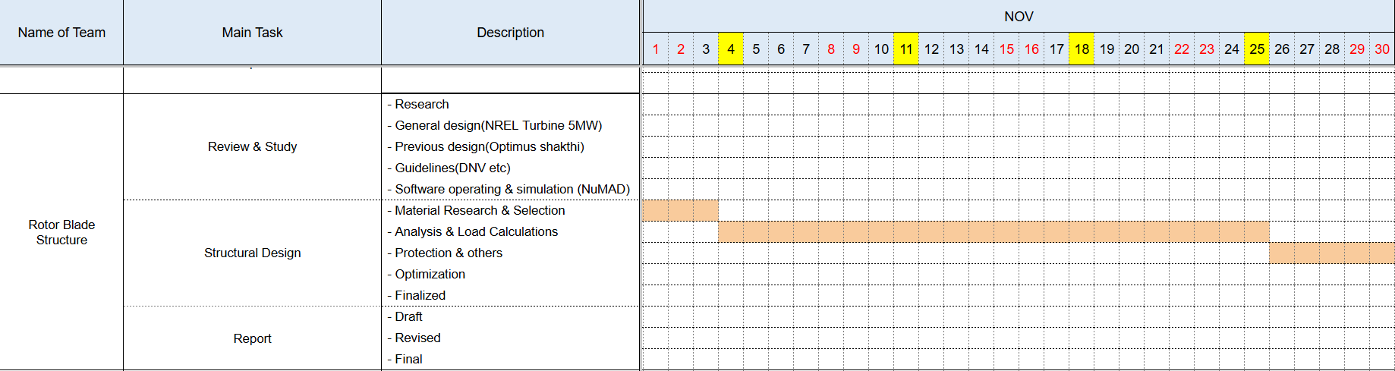
1. Team Time line
1.2 Team Time line for Month November -
Mithun Shetty

Slide 5
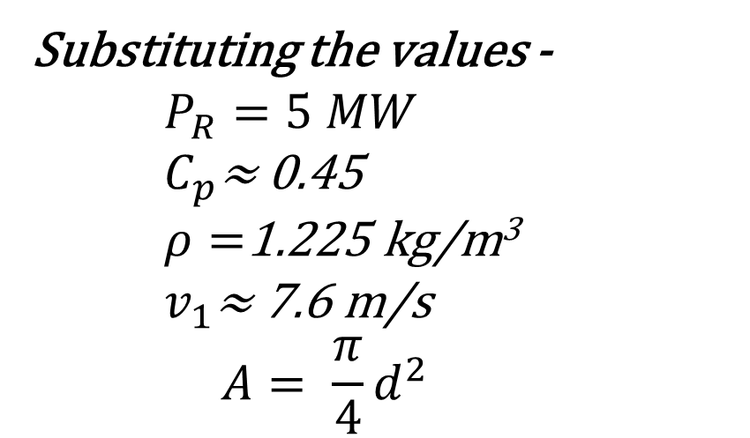
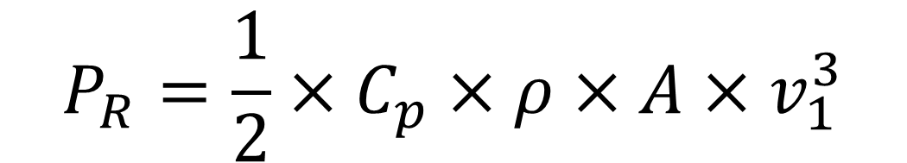
2. Fixing the length of Blade
$$P_{R}=\frac{1}{2}×C_{p}×ρ×A×v_{1}^{3}$$
Substituting the values -
$$P_{R}=5 MW$$
$C_{p}\text{≈}$ 0.45
$ρ=$1.225 kg/m³
$v_{1}\text{≈}$7.6 m/s
$$A= \frac{π}{4}d^{2}$$
We get –
D ≈ 160 m
R ≈ 80 m
Mithun Shetty

Slide 6
3. Fix the nodes along the length of Blade -
As per Optimus Shakthi 2024 the number of nodes is equal to 11 (R = 87 m)
According to NREL 5MW the number of nodes is 17 (R = 63 m).
As per the length of Optimus Syria Rotor Blade (R = 80 approx.) it is decided by the Aerodynamics Team.
Using above data we are doing calculation to accommodate feasible number of nodes to provide both structural strength and good aerodynamic lift as well.
We are yet to fix the number of nodes and the distance between the nodes.
Once we get the actual blade geometry from the Aerodynamics Team. We will decide the above mentioned factors.
Mithun Shetty

Slide 7

4. Blade Root Diameter Details
As per our assumptions based on Optimus Shakthi we calculated the blade root diameter.
Using the formula,
here,
D_{b} = External (outer) Blade Root Diameter
D_{bhc} = Bolt Hole Circle diameter
H = Root Thickness
D_{bhc} = 3.725 m (approx.)
H = 125 mm (as per standards to prevent the bearing failure from the T Bolts)
D_{b} = 3.6 m (as per Optimus Shakthi)
Mithun Shetty

Slide 8
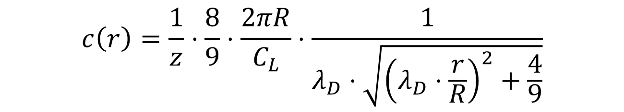
5. Chord Length Formula -
$$c\left(r\right)=\frac{1}{z}⋅\frac{8}{9}⋅\frac{2πR}{C_{L}}⋅\frac{1}{λ_{D}⋅\sqrt{{\left(λ_{D}⋅\frac{r}{R}\right)}^{2}+\frac{4}{9}}}$$
here, c(r) = Chord Length (m)
z = No. of Blades (m)
R = Rotor Radius (m)
C_{L} = Lift Coefficient
λ_{D} = Designed Tip Speed Ratio
Mithun Shetty

Slide 9
6. Data needed to proceed further
As per the instructions from the Management Team We have decided the no. of air foils from 11 to 17 approx. as mentioned in the last slide.
So If the length of blade changes the distance between two nodes is altered only once we get the final blade geometry (2D & 3D Model)
For this, We fix the Blade Geometry using NREL & Optimus Shakthi for sometime to start with dealing the structural aspects
The final Laminate thickness (H) will be calculated once we get the final blade geometry from Aerodynamics Team
Mithun Shetty

Slide 10
7. Tasks planned for upcoming weeks -
Material Selection
Spar Cap & Shear Web Thickness
Develop Blade Model in NuMAD
Analysis with Precomp
Iterate and refine the design
Mithun Shetty

Slide 11
Bibliography
Definition of a 5 MW/61.5m Wind Turbine Blade Reference Model by Brian R. Resor, Sandia National Laboratories, California, USA
Definition of a 5 MW Reference Wind Turbine for Offshore System Development, J. Jonkman, S. Butterfield, W. Musial, and G. Scott, National Renewable Energy Laboratory, USA
Reports from Optimus Shakthi 2024
Mithun Shetty

